Slide 1



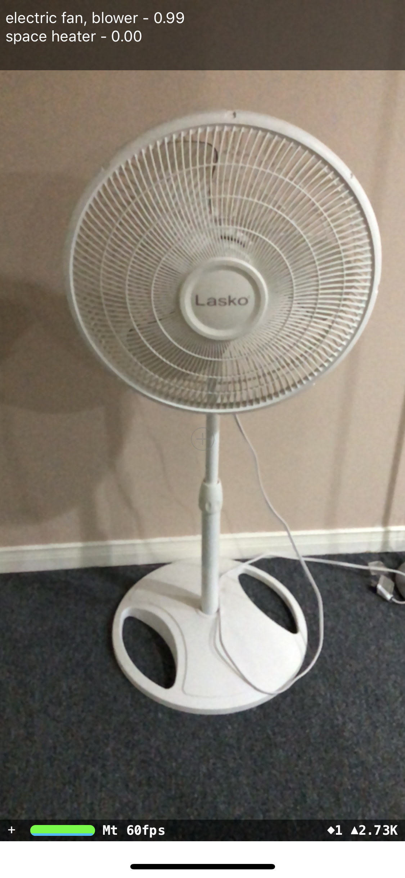
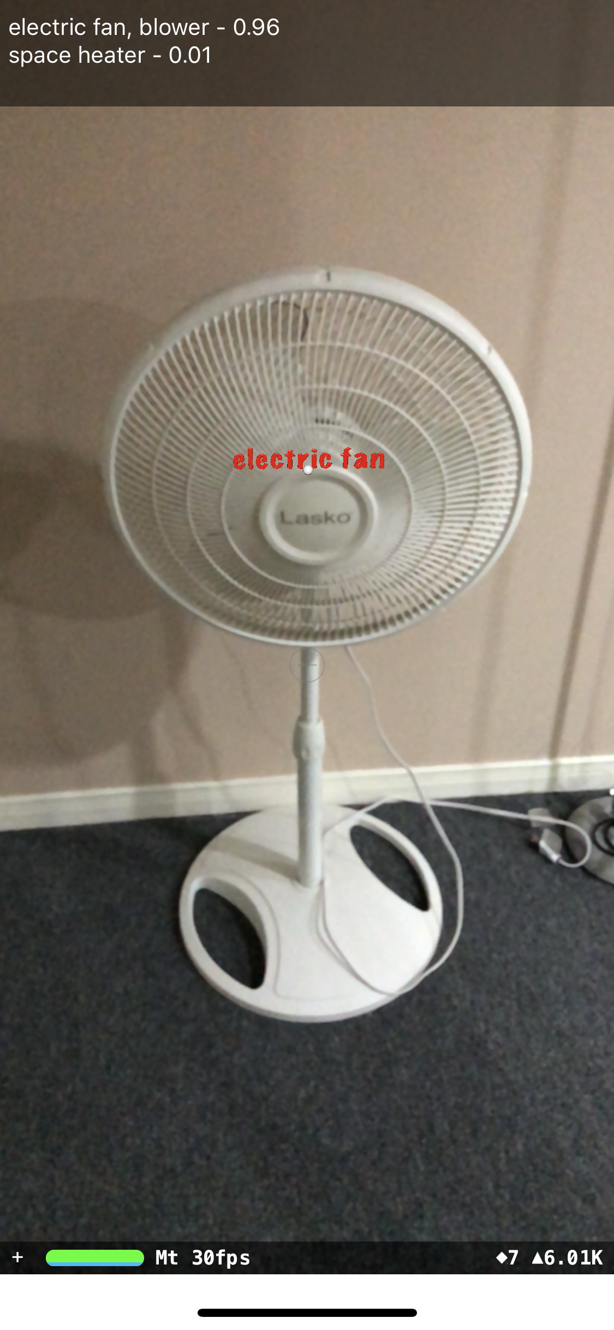
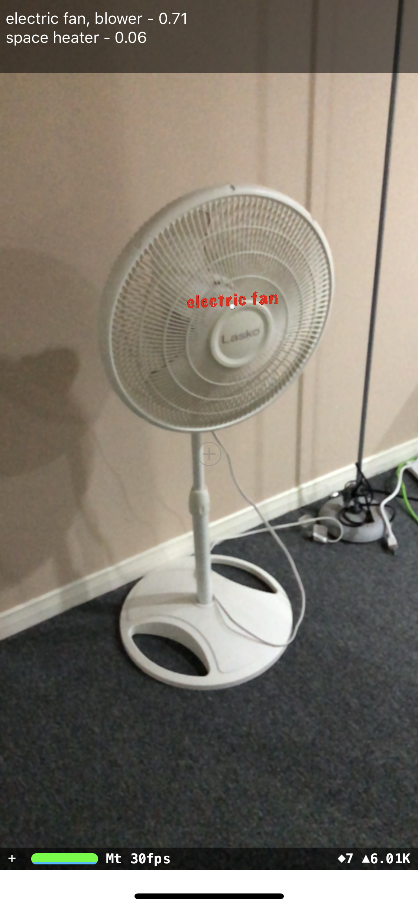
Object Recognition using Machine Learning Method and Tagging in Augmented Reality
Afnan Ahmad, Gunho Sohn
Geomatics Engineering, Depart. Of ESSE, York University,
4700 Keele St., North York, ON M3J 1P3 - {aafnan, gsohn}@yorku.ca
Abstract
Machine Learning is enabling computers to learn without explicitly being programmed. This is helping humans to teach computers to adapt and identify new things. On the other hand, Augmented Reality is the integration of digital information with the user's environment in real time. The focus of this research is to recognize objects on a mobile device using Machine Learning methods and offer the ability to tag those objects in Augmented Reality. Machine Learning models can be trained to recognize new types of objects and this information can be overlaid in Augmented Reality without any changes to existing solution. Since this solution is running on a mobile phone, therefore, no expensive or complicated hardware or software setup is required. Our current solution has an accuracy of 70% which can be further improved by more training with a larger data set of samples for target objects which are requiring to be recognized. Surveyors can use this solution to identify and tag different types of objects. In future iterations, we intend to enhance the functionality by adding more features such as automatically counting different recognized objects.
Motivation
Experiments
Latest advancements in Augmented Reality such as Apple’s ARKit and ARCore on Android made it more flexible to use AR on mobile devices.
Availability of platform for mobile devices to run Machine Learning techniques (e.g. classification).
Possible classifications
with confidence
Background
Centered Object
to be classified
G. Dandachi, A. Assoum, B. Elhassan and F. Dornaika, "Machine learning schemes in augmented reality for features detection," 2015 Fifth International Conference on Digital Information and Communication Technology and its Applications (DICTAP), Beirut, 2015, pp. 101-105.
N. Y. Khan, B. McCane and G. Wyvill, "SIFT and SURF Performance Evaluation against Various Image Deformations on Benchmark Dataset," 2011 International Conference on Digital Image Computing: Techniques and Applications, Noosa, QLD, 2011, pp. 501-506.
W. Daniel, R. Gerhard, M. Alessandro, D. Tom and S. Dieter, Pose Tracking from Natural Features on Mobile Phones, Proc. International Symposium on Mixed and Augmented Reality, pp. 125-134, 2008.
FPS for Machine Learning
classification algorithm
(a) Initial Screen
Classified title in
Augmented Reality
Architecture
Camera
Sensors
Inputs
Vision
Augmented Reality
(b) Tagged item with
classified object title with
text in Augment Reality
(c) Tagged item from a different
angle
Processing
Conclusion
Machine Learning
Display
This experiment evaluates the feasibility of running a Machine Learning trained model on a mobile device to achieve high accuracy classification and demonstrates potential of Augmented Reality combined with Machine Learning. This project can be enhanced to add capabilities to aid surveying.
Classification
Output

